Slide 1
Assessment & Intervention Fundamentals
CDS 663 Week 2 – Begin Jim

Slide 2
Lecture Map Part A
Assessment
  Rationale for testing
  Characteristics of tests
  Cognitive Assessment domains
Assessment Approaches
  Standardized Testing
  Formal vs. Informal
  Timing and purpose of assessment
  Use of Hypothesis Testing
Outcome Measurement
  Goal Attainment Scaling

Slide 3
ASSESSMENT
You will (or have already) learned
Purpose of assessments
Review psychometric test concepts including: validity, reliability, base rate and sensitivity
Differentiate standard/nonstandard, formal/informal, static/dynamic

Slide 4
Primary Reasons for Assessment
Diagnosing a disease or disorder
Establishing that an individual meets criteria for classification or for qualification for services
Establishing degree of impairment for benefits or litigation
Formulating a prognosis
Establishing baseline and progress measures
Planning rehabilitative and educational intervention
Measuring outcome of therapy

Slide 5
Timing of Assessments often determines purpose
Initial Assessment: Documents baseline abilities, helps identify sources of concern; documents performance and participation prior to intervention; assists with treatment selection
Ongoing Assessment: Documents progress related to therapy goals and provides information useful for modifying intervention
Outcome Assessment: Documents final effects of intervention or condition after a discrete time period

Slide 6
CHARTR Clinical Decision Making
(Initial Assessment)
Am I making a diagnosis or determining the source of a problem?
OR
Do I already know the cognitive-communicative diagnosis?

Slide 7
Test Characteristics
Formal vs. Informal
  Degree to which procedures are well prescribed and define
Standardized vs. Non-standardized
  All standardized tests are formal; some non-standardized test are formal; all informal tests are non-standardized
  If standardized, need to know the psychometric properties
Static vs. Dynamic
All standardized tests are static; non-standardized tests may be either

Slide 8
Need to know psychometric properties of tests..
Reliability
Validity
Base Rate phenomena
  Probability of condition occurring in general public (leading to false positives)
Sensitivity
  If lacking, leads to false negatives
Review the types of reliability and validity coded in Turkstra et al (2005)

Slide 9
The Tension when Selecting Outcome Measures for Cognitive Rehabilitation
Person-Centered Focus
(meaningful, ecological)
Measurable
(reliable, observable)
In a review of 31 tests assessing cognitive-linguistic skills:
None of the tests were predictive of performance in contexts relevant to daily life (ecological validity)
Turkstra et al, 2005

Slide 10
Limited Time for Evaluation
Typical evaluation: Test → Infer Function → Plan Treatment
Standardized, impairment-level test
Infer the degree to which impairments will likely impact everyday activities
Plan treatment accordingly

Slide 11
Can be hard to find “ecologically valid” standardized tests..
Executive functions: Testing environment may mask problems; base rate problem…often around 50%;
Discourse/pragmatics: Sensitivity to context; base rate problem, reliability for assessing more complex functions

Slide 12
Static/Descriptive vs. Dynamic/Experimental
Static: Measures performance w/out attempting to identify the factors that influence performance (positive or negative)
Dynamic: Attempts to identify the effects of factors.
  Test-retest is one example
  Flexible testing—accommodating an impairment
  Experimental...try altering administration according to hypothesis

Slide 13
Cognitive Assessment Areas
Orientation/Arousal
General Cognitive/Intellectual Abilities
General Measures of Disability and Outcome
Attention
Memory & New Learning
Executive Functions

Slide 14
Orientation/Arousal
COMA: different instruments used to measure (Glascow Coma Scale awards points for eye opening, best motor response, best verbal response)
PTA (GOAT is an example of instrument and looks at orientation to person, place, time & circumstance)
Scales to track progress: most widely used is the Rancho Los Amigos Levels of Cognitive Functioning

Slide 15
GLASCOW COMA SCALE
Notes:
Severe: GCS 8 or less
Moderate: GCS 9-12
Mild: GCS 13-15

Slide 16
Rancho Scale Mnemonic
Rancho Levels Song
Rancho Levels Website
Notes:
The Rancho Los Amigos Scale is an easy way to describe a brain-injured
person's level of activity. The levels look simple and direct but in real life, not
everyone will move smoothly through each level. A brain-injured person may
move from Level 2 to Level 4 and never show any true Level 3 activity.

Slide 17
General Measures of disability and outcome
FIM (Functional Independence Measure) one of the most widely used outcome measures. It is a 7-level scoring system; cognitive portion is only a small amount of the total variance of test; correlates with GOS; only a very blunt measure of outcome
FAM(Functional Assessment Measure) extends FIM for cognitive and psychosocial issues; a bit more broad
Disability Rating Scale (DRS) a bit more sensitive

Slide 18
Functional Assessment/Collaborative Contextualized Hypothesis Testing
(Ylvisaker & Feeney, 1998; Coelho et al, 2005)
Ongoing
  disability and contexts change
Contextualized
  ecological validity of standardized testing is questionable
Collaborative
  increasing the number of people who participate increases perspectives and variety of observations and the contexts; more people likely to be involved in intervention
Hypothesis testing assessment
  all behavior is multiply determined

Slide 19
Hypothesis Testing (Dynamic Assessment; Functional Assessment)
Components/Implementation:
  Problem identification
  Hypothesis formulation
  Hypothesis selection
  Hypothesis testing
  Formulation of intervention plan
  Ongoing review

Slide 20
Hypothesis Testing Example
Observed reading problem..what is the source?
Physical issue?
Sensory issue?
Cognitive issue?
Language issue?
Academic issue?
Emotional?

Slide 21
Measuring Treatment Progress
Changes in processing/abilities
  Test/Retest on psychometrically sound tests
Changes in skills/functional activities
  Observation-Based: Functional Assessment, Rating scales, Counts/Sampling
Progress on patient-selected goals
  Goal Attainment Scaling

Slide 22
Summary
Examiner needs to…
Be clear about reason for assessment
Be knowledgeable about cognitive assessments and instruments
Select instruments for their sensitivity
Consider big picture: social, real world contextual variables
Span WHO model
Collaborative--involve the individual, family and relevant community members
Use Hypothesis Testing to determine source of concerns and guide selection of treatment

Slide 23
Let’s Talk Specifically about Outcome Measurement
What are the criteria that come to mind when you measure the outcome of your therapy?

Slide 24
What is Goal Attainment Scaling?
A method of measuring outcomes that are specific, sensitive and meaningful to clients
Uses a collaborative interview process to generate functional goal domains that would be expected to change with therapy
Delineates different objective levels of possible progress
Becoming increasing more common as there is a call for patient-centered outcomes

Slide 25
Goal Attainment Scaling
Goal selection
Weighting goals,
Articulating the “expected” level of outcome in objective, measurable terms
Articulation of other outcome levels
Assessment of GAS level pre and post treatment.

Slide 26
Advantages of GAS
Captures individual variability
Shows high sensitivity to change in the areas that individuals have deemed as most important to them.
There is therapeutic value from the GAS process specific to brain injury rehabilitation.
  What did your reading say about this?

Slide 27
More advantages
Can delineate the degree of change
Can be used to measure intervention effects on hetergenous populations with different comorbidities
Aligns the therapist and the patient

Slide 28
GAS CRITERIA
Specificity
Measurability
Attainability
Relevant
Time-specificity
Equidistant
uniDimensional
(Ruble et al., 2012)
SMARTED Goals
Notes:
SMART goals provide key criteria in ALL goal development, with two additional dimensions
TO DO THIS WELL….like all assessments takes training and practice.

Slide 29
Definition of levels of attainment
+2 Much more than expected
+1 Somewhat more than expected
0 Expected level of outcome
-1 Somewhat less than expected-BASELINE
-2 Much less than expected

Slide 30
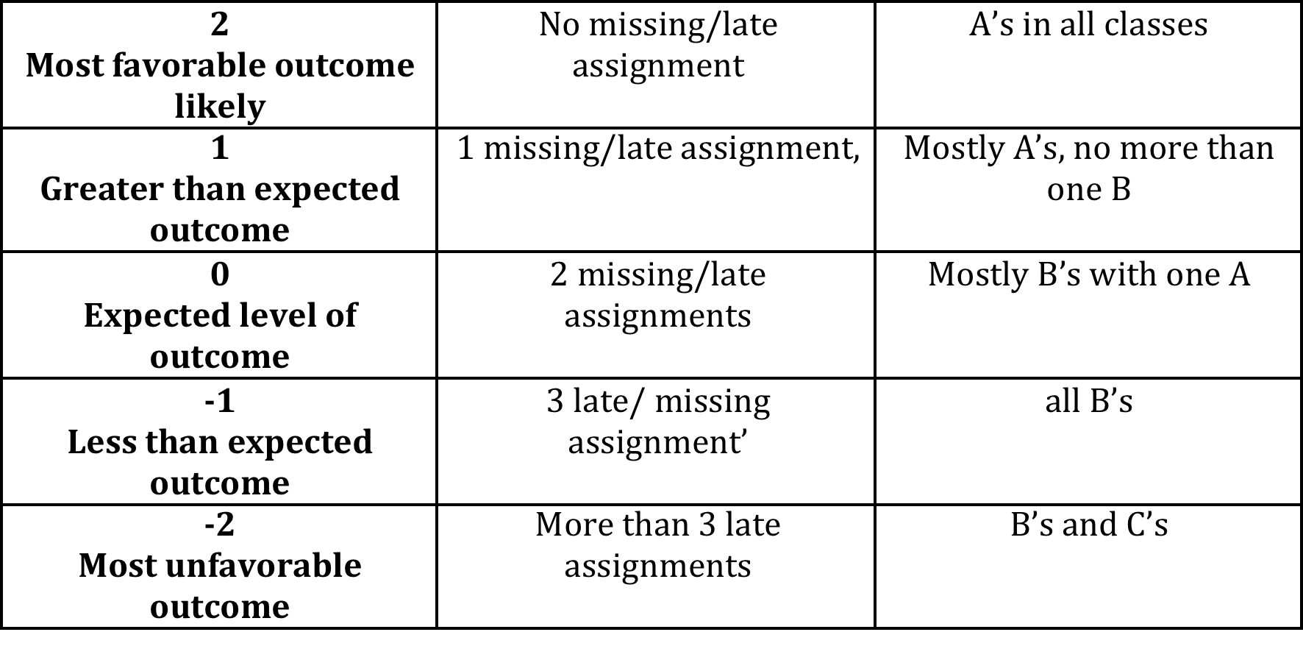
Functional Domain: School Performance/Assignment Management
Cognitive Domain: Executive Functions
Intervention Approach: Use of planner
Measurement: Missing/late assignments reported on school website; GPA

Slide 31
Inpatient clinical case study
Background
Age: 34 year old male
Diagnosis: Moderate TBI, GCS 9 in ER
Currently: Rancho V (Confused-appropriate)
Etiology: Rock climbing fall
Neuroimaging:
Large left subdural hematoma with mass effect necessitating a left-sided craniotomy and surgical evacuation
Hemorrhagic contusions of right and left frontal lobes, R > L
Time since injury: 4 weeks
Living situation: married with 2 children
Employment: teacher
Johnson, S & Frey, K, ASHA, Denver, CO, 2015

Slide 32
Inpatient clinical case example
Cognitive communication problems & strengths
Presenting problems:
Fluent aphasia – paraphasias and impaired comprehension
Poor memory - inability to recall daily routines
Poor attention – difficulty staying focused
Impaired safety awareness
Impaired independence
Strengths:
Recognized people
Expressed self with ~ 40% success, 60% paraphasias
Could follow simple directions, write and read simple information
Johnson, S & Frey, K, ASHA, Denver, CO, 2015

Slide 33
Step 1: Assessment &
Step 2: Goal setting - Inpatient Case
Assessment:
  Chart review –
    understanding of neuroanatomy
    social, educational, work history
  Boston Naming Test
  Western Aphasia Battery
  Orientation Log
Goal setting (begin with the end): GET THE #$!! OUT OF HERE
  improve SAFETY by learning to use the call light
  improve INDEPENDENCE by coming to therapies
Johnson, S & Frey, K, ASHA, Denver, CO, 2015

Slide 34
Example questions | Example responses
“What do you want to work on?” | “Get the #$!! out of here.”
“What’s getting in the way of you being able to do that?” | “This stupid belt and nurse that’s with me all the time.”
“Getting rid of the belt and your nurse will help you work toward getting out of here?” “What can you do to get rid of the belt and nurse? | “They tell me I need to use the call light and follow my therapy schedule. They say at some point I should be showing up to my therapies on my own.”
“Are you using your call light any time right now or showing up to your therapies on your own?” | “I use my call light sometimes and know where some of my therapies are.”
“Can you put a number to how often you use the call light during the day or you know where your therapies are?” | “Maybe I use the call light once during the day. I don’t go to any of my therapies on my own”
“What does ‘doing a little better or worse with that’ look like?” | “Maybe using my call light 3 times during the day.” “Maybe use my planner to help me know where to go for at least one therapy session.”
“How will you measure your progress?” | “Write it down on my form”
“How will you remember to keep progressing with your goal?” | “Tell staff/therapists and my family that I want to do this so they can remind me if needed.”

Slide 35
Goal Attainment Scaling
Goal: Get rid of behavioral attendant
Level of Attainment | Goal 1 Safety: Get rid of 1:1 attendant Uses call light | Goal 2 Independence: Come to therapies I’ly | Goal 3 Independence: Improve communication w/ wife
Much more than expected + 2 | Uses call light 5 of 5 opportunities during the day | I get myself to my therapies and to my meals
Somewhat more than expected + 1 | Uses call light 4 of 5 opportunities during the day | I tell my family how to get to my therapies and my meals
Expected level of outcome 0 | Uses call light 2-3 of 5 opportunities during the day | At least one time during the day I tell my family to look in my planner so they know where I need to go
Somewhat less than expected - 1 | Uses call light 1 of 5 opportunities during the day | My family takes me to my therapies and my meals
Much less than expected - 2 | Uses call light 0 of 5 opportunities during the day | I become easily agitated by any daily routines

Slide 36
Inpatient clinical case study
Treatment construction
Goal | Context | Materials | Task | Support / Cues
1. Safety: Use the call light | Room | Steps for using the call light Index cards | Review steps for the call light He write each step on index card Review steps – he put cards in order Practice using call light | Simplify steps Errorless learning Review-Say-Do
2. Independence: Coming to therapies on his own | Office Hallways Room Gym | Planner Daily schedule | Review schedule of day Practice route for schedule Practice initiation of telling staff / family where he is going | Consistent paths Point out landmarks Verbal / visual cues for him to initiate telling staff/family
Johnson, S & Frey, K, ASHA, Denver, CO, 2015

Slide 37
The GAS Process
Goal | Live on my own with weekly check-ins & help as needed by family (3 hours or less weekly)
+2 Much more than expected | Live on my own with weekly check-ins & help as needed by family (3 hours or less weekly)
+1 More than expected | Live with family and get help for 25% of daily activities.
0 Expected | Live with family and get help for 50% of daily activities.
-1 Baseline | Live with family and get help for 75% of daily activities.
-2 Decline | Live with family and get help for nearly all daily activities (more than 75%).

Slide 38
Summary of Benefits for GAS
Client-centric versus population-centric
  Individualized vs. global measure
Accommodate different goals for same client
Aggregate results across clients receiving the same treatment with different goals
  Practice-based evidence
Can objectively assess degree of goal attainment – outcome measure

Slide 39
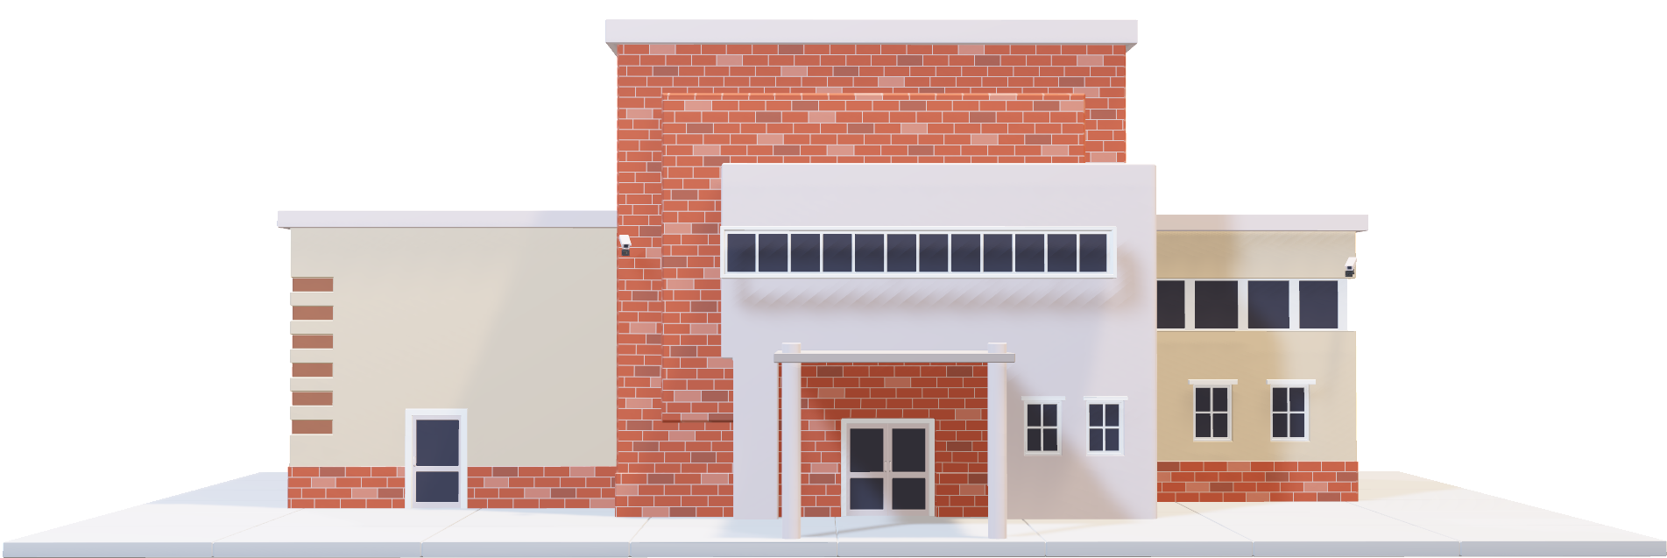
Welcome to Consolidation Station

Slide 40

Review & Chew 1

Slide 41
Lecture Map Part B
Increasing Client Buy-In (Building Therapeutic Alliance)
  Need to promote self-efficacy, motivation, and trust
  Challenges may be due to deficits in self awareness, psychological conditions (denial, depression)
SLPs need to know how to promote resilience
  Tools: client-centered goal setting, collaborative interview skills and MI
  Therapy approaches to decrease deficits in self awareness and increase motivation
Big picture flow of therapy that can promote resilience and self-efficacy
  Four phases of cognitive rehabilitation (from Clinician’s Guideline)
  Dynamic Coaching

Slide 42

Resilience

Slide 43
Reading & Podcast Review
Clinician’s Guide to Cognitive Rehabilitation in Mild Traumatic Brain Injury
Hillig, Ma & Dorsch (2019)
  What were the components of the intervention used in the article?
  Why do you think this was an effective intervention?
Called to Care (podcast)

Slide 44
What Increases Patient Buy-In?
“I can do this.”
Self-Efficacy
“This is a goal that matters to me.”
Motivation
“I believe that you understand, care and can help me."
Trust

Slide 45
What Decreases Patient Buy-In?
Organic
Factors
Anosagnosia/Lack of Self Awareness
Apathy syndromes
Pre-Injury Psychological Traits
Negative emotionality
Response to
Impairment
Reactive depression
Low expectation for improvement
Mental health conditions
Denial
Defensive coping style

Slide 46
APATHY FOLLOWING TBI: Cardinal feature is diminished goal directed behavior due to disruption in motivation, emotion, cognitive and/or motor processes. Drive-state and emotional learning disrupted.
(Worthington & Wood, 2018)
Anosognosia: Neurological disorder resulting in a deficit in self-awareness of disability.
Depression: Mood disorder typically characterized by feelings of sadness, emptiness, pessimism, and/or helplessness.
Denial: Psychologically motivated symptom that serves to protect a person from despair.

Slide 47
If I could just go home, I’d be able to do all these things. I’ll wait till I get home to try.
The therapists here are all controlling and poorly trained. I need to go to go where there are experts.
I just want to sit here.
There isn’t anything that
I want to work on.
I never was good at this before so that is why it is hard now.

Slide 48
Theoretical model of possible trajectories following trauma
Resilient re-integration (e.g., acceptance of limitation after an injury but development of new interests and activities)
Re-integration with loss (e.g., engage in wheelchair sports)
Re-integration back to homeostasis (e.g., life activities return to previous state after a traumatic injury)
Dysfunctional re-integration (e.g., depression, isolation, substance abuse)
Richardson GE. The metatheory of resilience and resiliency.
Journal of Clinical Psychology. 2002;58:307–321.

Slide 49
FROM THE RESILIENCE LITERATURE….
The process of psychological reintegration is the ability to learn new skills from the disruptive experience in a way that will allow one to negotiate life events.
Preventing the negative trajectory of recovery requires individuals to figure out the value of personal disruption and adversity as avenues to promote growth and adjustment.
How can we as SLPs facilitate these adaptations?
Neils-Strunjas, J. et al., (2017) Role of resilience in the rehabilitation of adults with ABI. Brain Injury, 31(2), 131-139.

Slide 50
Essential Clinical Skill Sets for Facilitating
Client Buy-In &
Positive Adaptation
Intervention Techniques for Managing Deficits in Unawareness and Promoting Resilience
Techniques for Building Therapeutic Rapport

Slide 52
Motivational Interviewing (MI)
One Part Philosophy
Client Autonomy
Resist the ‘Righting Reflex’
One Part Communication Technique
OARS

Slide 53
Motivational Interviewing Techniques (OARS):The Path to Collaborative Goals
(Miller & Rollnick, 2012)
Open-Ended Questions
  How can I help you? How do memory challenges affect you at work?
  vs.
  Do you have problems with memory? Can you remember the things you need to do at work?
Affirmation
  Even though you didn’t always use your strategy on vacation, you did remember to use it twice in very difficult situations, you should feel good about that.
  vs.
  Nice job
Reflections
  You have trouble reading textbooks, your mind wanders.
  vs.
  I see, are you distracted?
Summaries
  Summaries collect a number of things said by the client presented back to the client for validation
vs. Yes/No Questions
vs. A simple compliment
vs. More questions
the opportunity for collaboration

Slide 54
MI in Action…
https://www.youtube.com/watch?v=_VlvanBFkvI
What MI techniques were violated?
Thoughts?

Slide 55
Round 2
https://www.youtube.com/watch?v=67I6g1I7Zao&t=34s

Slide 56
An Operational Definition of a Collaborative Goal Using MI Techniques
A goal in which:
the functional context, functional activity, and cognitive context for that goal are identified through client responses to open-ended questions or reflections by the clinician
and validated by the client in response to a clinician summary of that information.

Slide 57
Four Interview Components When Collaboratively Setting Goals (GAS Goals)
Identifying the problem
  Cognitive-communication domain (attention, memory, language)
  Functional Domain/Context (grades/school; household management; social communication)
Facilitating Buy-In
Selecting Therapy Approach
Generating Goal Hierarchies

Slide 58
An Operational Definition of a Collaborative Goal Using MI Techniques: An Example
Open-ended question: How can I help you?→ I’m really struggling in school, my test grades are terrible
  Functional Context = school
Open ended question: Tell me how do you study? → Well I try and read these chapters and it’s a lot harder than it used to be
  Functional Activity = reading college textbooks
Reflection: It’s hard to keep your focus when you are reading → Yes, my mind wanders, my eyes are moving across the page like I’m reading but I’m thinking about something completely different
  Cognitive Context = distractibility

Slide 59
An Operational Definition of a Collaborative Goal Using MI Techniques: An Example
Summary: So what I hear you saying is that you’re struggling on tests in school because reading the chapters is hard. You lose your focus and become distracted – you can’t keep your mind on what you’re reading.
→ Yes, and it’s a huge problem for me. I can’t remember what I read.
Possible Level 0 Goal – Expected Outcome
  Goal: Client will use _______ strategy to maintain attentional focus while reading and will identify episodes of distractibility no more than once every 5 pages.

Slide 60
Let’s Back Up to the Big Picture: How does goal setting fit in the larger context of therapy?
Clinical Guidelines Manual Developed for mTBI

Slide 61
Guiding Principles
Rehabilitation Stages
1. Focus on Function
2. Cultivate Partnerships
3. Acknowledge Multifactorial
complexities
4. Building a Team: "There's no
"I" in Team"
5. Recruit Resilience
6. Promote Realistic Expectations
for Recovery
Getting Started
Setting Stage For Functional Change
Making Functional Change
Transition to self management
Six Cognitive Interventions
Personalized education
Cognitive strategy training
Direct training
Assistive technology for cognition
Task specific training
Environmental management
TOOLS: Motivational interviewing; goal attainment scaling, dynamic coaching
Roadmap for Functional Cognitive Rehabilitation

Slide 62
Overview
Get Started
  Establishing the therapeutic alliance, information gathering, engage & motivate
Set the Stage for Functional Change
  Client selects goals, treatment approaches, measurement plan
Make Functional Changes
  Engage in therapy, 6 approaches to cognitive rehabilitation, monitor progress, goal attainment
Transition to Self-Management
  Plan for discharge, evaluate outcomes

Slide 63
Dynamic Coaching
Acknowledgement: Don MacLennan, Minneapolis Veterans Administration Medical Center
Collaborative problem-solving interaction
Clinician functions as a coach, modeling and explicitly instructing self-regulation
Both clinician and client are considered experts
It is a method to develop a specific goal, identify a strategy/therapy approach to support that goal, monitor outcome and evaluate goal attainment
Ultimate goal is for patient to engage in self-coaching process
Requires some degree of self-awareness

Slide 64
Identify specific challenges
Select optimal approach and back-up
Create steps for implemen-tation
Initiate treatment plan
Monitor implemen-tation
Select doable goal
Identify potential approach-es or supports
Monitor outcome
Adjust goal, or adjust approach

Slide 65
Six Guiding Principles
Recruit Resilience
Identify & incorporate values of patient into therapy
Promote self-efficacy, positive expectation, sense of meaning
Cultivate the Therapeutic Alliance
A strong partnership provides the foundation for the therapeutic process
Listen carefully to the patient and resist the impulse to be the expert
Acknowledge multifactorial complexities
Persisting cognitive symptoms are often maintained by factors other than the brain injury
Regardless of the lack of clarity surrounding cause of cognitive symptoms, the symptoms are real and the therapist must move beyond symptom attribution to help the patient function better

Slide 66
Six Guiding Principles
Build a team
Include family wherever possible – family support is a strong prognostic variable for recovery
Other team members are driven by specific needs: Physicians for medical tx, Mental Health providers for mood disorders, PTSD, Social Work for community services as needed
Focus on function
Overarching goal of cognitive rehabilitation after mTBI is to help people resume valued activities
This is best accomplished when therapy itself is integration-focused and directed at functional activities in a community context
Promote realistic expectations for recovery
Positive expectation for recovery is critical for developing self-efficacy and self-determination
Provide education about nature of mTBI and expected recovery, highlight abilities and strengths, and demonstrate effectiveness of strategies in resuming everyday activities

