Slide 1
Concussion Biomechanics, Pathophysiology, and SLP role in clinical Management
CDS 663 Winter 2021

Slide 2
Outline
Concussion 101
Epidemiology
Biomechanics of concussion
Neurometabolic cascade
Connecting the physiological change to clinical symptoms
Clinical treatment of concussion
Acute vs persistent stage (PCS)
Identifying multidisciplinary concussion management team members
Role of the SLP

Slide 3
Epidemiology
1.6-3.8 million annual concussions in U.S.
Estimated 300,000 SRC annually in U.S.
SRC and MVA most common causes ages 15-24
(Marar, McIlvain, Fields, & Comstock, 2012)
(Giza & Kutcher, 2014)
(Gonzalez & Walker, 2011)

Slide 4
(Marar et al., 2012)

Slide 8
(Myer et al., 2015)

Slide 9
Definition:
The application of biomechanical force to the head and/or neck via linear and/or rotational acceleration that leads to observable changes in cognitive, somatic, and neurobehavioral functioning

Slide 10
If force results in concussion, why don’t woodpeckers sustain them?
FORCE = MASS X ACCELERATION
Three Specific Factors:
Small brain size and mass
Short duration of impact
Orientation of the brain within the woodpecker skull
(Wang et al., 2011)
(Gibson, 2006)

Slide 12
(Wang et al., 2011)

Slide 13
(Wang et al., 2011)

Slide 14
Keys to the Biomechanics of Concussion
Force = Mass X Acceleration
Human brain = 1400 g
Given fixed mass, force applied increases as acceleration increases
Impact duration
As duration increases, applied force decreases
Tolerable acceleration range of human impact: 80-160 g

Slide 15
Impulse Magnitude
Force during the impact / Duration of the impact
That’s why helmets are important:
Prevent skull fractures
Reduce direct energy transfer resulting from skull-to-skull contact
Reduce the rate of head acceleration by increasing impact duration, thus reducing force to the head
Style - Danish Bike Helmet

Slide 17
Effective Mass
(Broglio, Surma, & Ashton-Miller, 2012)

Slide 18
The principle of effective mass in the wild:
HALO Concussion Collar

Slide 19
Neurometabolic Cascade of Concussion

Slide 21
stages of the cascade
Biomechanical force applied to head/neck region and transferred to brain
Ionic flux and mass release of glutamate
Energy crisis
Cytoskeletal damage and axonal dysfunction

Slide 22
(Giza & Hovda, 2014)

Slide 23
Ionic flux and mass release of glutamate
Glutamate is the primary excitatory neurotransmitter in the CNS
Application of force triggers mass release of glutamate – significantly depolarizes the axon
Depolarization:
K⁺ ions pumped out of the neuron
Na⁺ and Ca⁺ ions pumped in

Slide 24
Energy crisis
Hyperglycolysis to restore homeostasis
Over-pumping of sodium-potassium ion channels quickly burns through the neuron’s energy reserve
“Uncoupling” of glucose metabolism and cerebral blood flow (CBF)
Demand goes up, supply goes down
Very significant as the brain accounts for 15% of total body metabolism
Metabolism further exacerbated by the accumulation of calcium in the mitochondria
“Spreading depression”

Slide 25
(Giza & Hovda, 2014)

Slide 26
Cytoskeletal damage and axonal dysfunction
Intra-axonal calcium flux negatively affects the structural integrity of axons
Biomechanical force causes the stretching of axons – causes axonal blebbing
Force also disrupts microtubules that line the axonal membrane
Interferes with axonal transport
Can even result in the disruption of neural transmission at the synapse and cause axonal disconnections

Slide 27
(Giza & Hovda, 2014)
Notes:
1. Signal strikes and leads to depolarization and action potentials
2. Ionic flux – mass release of glutamate – sneaks through the AMPA channel, kicks out the magnesium blocking the NMDA channel to allow a larger flow of glutamate through this pore.
3. Potassium efflux, sodium and calcium influx
4. Increased pumping to return cell to homeostasis which leads to…
5. Hyperglycoloysis – initial spike in the production of energy to support the pumps
6/7. Combination of decreased blood flow and accumulation of calcium in the mitochondria causes the neuron to reach a state of prolonged depression where ATP cannot be produced
8. Calcium influx along the axon interferes with axonal functioning and damages the integrity of the axonal structure.
Point out importance of NMDA and AMPA receptors:
NMDA receptors have huge pores! Many different ions easily travel through when their opened like our friends K⁺, Na⁺, and Ca⁺
NMDA receptors are closed at resting membrane potential because Mg blocks the channel
A voltage change is required to open NMDA receptors
However, AMPA pores provide a simpler and faster receptor for glutamate to bind to and open the pore
Therefore, Na⁺ will rush in through the AMPA channel, kick out the Mg that is blocking the NMDA receptors, and create a voltage change to open the NMDA floodgates
Important side note not seen in the picture: glycine must be present in the extracellular space for NMDA to open
In short, for NMDA to open, there must be:
Deplorization that induces a voltage change
Glycine in the extracellular space

Slide 29
Early events of the neurometabolic Cascade
Mass release of glutamate and efflux of potassium/influx of sodium that triggers brief period of hyperglycolysis
Persistent calcium influx
Mitochondrial dysfunction that reduces glucose metabolism to depressed state
Reduced CBF
Axonal injury

Slide 30
Late events of the neurometabolic Cascade
Recovery of glucose metabolism and CBF
Delayed cell death
Chronic alterations in neurotransmission
Axonal disconnection

Slide 33
Symptom Clusters
More recent research suggests there are 6 symptom clusters (Lumba-Brown, 2019, Harmon, 2019)
Headache-Migraine Symptom Cluster
Cognitive Symptom Cluster
Anxiety-Mood Symptom Cluster
Ocular-Motor Symptom Cluster
Vestibular Symptom Cluster
Sleep Symptom Cluster

Slide 34
PCS Defined
Occurs in 10-15% of the 1.6-3.8 million annual concussion cases
Shift in literature to use the term “Persistent Concussion Symptoms” instead of “Post Concussion Syndrome”
General consensus between DSM-IV and ICD-10 in diagnostic criteria of PCS
Defined as the presence of three or more persistent symptoms for at least three months following the injury

Slide 35
There are many mediators of cognitive symptoms responsible for persistent effects
Attention, memory, executive functions: What SLPS focus on
COGNITIVE SYMPTOMS
IATROGENIC
FACTORS
Incorrect diagnosis (cervicogenic), over-investigation/over-testing, over treating
Creates expectation of lasting symptoms
COMORBID
CONDITIONS
Depression, anxiety, PTSD, chronic pain, fatigue, sleep disturbance
All can contribute to maintenance of PCS
PSYCHOLOGICAL
FACTORS
Expectation as etiology, recall bias good old days, perception of little/no control, symptom-focused hypervigilance, personal gain
PRE-INJURY
FACTORS
Diminished resilience (self-efficacy, optimism & positive emotions, positive
reframing of negative thoughts, social support, sense of purpose in life),
Personality characteristics (neuroticism, low self-esteem, poor coping)
Previous concussions; Maternal hx of migraines
Our interventions must address the key issues beneath the surface

Slide 36
Biopsychosocial Conceptualization of PCS presented by Silverberg & Iverson (2011)

Slide 37
Pre-Injury Injury Related Post-Injury
(3-12+ months)
Individual factors:
Genetics
Development
Social
Psychological
Alteration of brain physiology
Symptom severity
Context of injury
Psychological response to injury
Coping skills
Nocebo effect
Iatrogenic factors
Misattribution

Slide 38
(Kenzie et al., 2017)

Slide 39
Slocum Orthopedics – Dr. Michael Koester
Medical evaluation
ImPACT testing
Symptom evaluation
Identification of risk factors
Physical Therapy
(Cooperative Performance and Rehabilitation)
Vestibular rehabilitation
Slocum Orthopedics – Dr. Ryann Watson-Stites
Neuropsychological testing
Symptom evaluation
Identification of risk factors
Triage
Cognitive Rehab (HEDCO)
Learning supports
Cognitive strategies
Goal setting
School Coordination (CBIRT)
School education
Accommodations
504Plan/IEP oversight
Mental Health
(Strong Behavioral Health)
Cognitive Behavioral Therapy to address:
Anxiety/depression
Pain management
Sleep support
Neurology
Chronic symptom management
Headache management

Slide 40
Acute Phase
Prolonged
100% of
concussion patients
15% with prolonged symptoms
Chronic
2% with long-term sequelae
NOW
0-8 weeks
> 8 weeks
> 1 year
Early Management Phase
Acute Phase
Our Goal
Prolonged
100% of
concussion patients
5% with prolonged symptoms
Chronic
80% of
concussion patients
<2% with long-term sequelae
0-10 days
2-8 weeks
> 8 weeks
> 1 year

Slide 41
Requirements for an integrated, coordinated team:
Designated lead
Range of necessary disciplines
Providers interested in concussion
Shared consent
System for reviewing progress

Slide 42
How SLPs can Treat PCS
Literature Influences
Proposed treatment model

Slide 43
Literature Sources for Adolescent Concussion Management
Four Specific Sources:
Position statements on school concussion management
Neuropsychology treatment literature
Adult cognitive rehabilitation delivered by SLPs
Pediatric cognitive rehabilitation delivered by SLPs

Slide 44
1. Position Statements on School Concussion Management
Return-to-Learn (RTL) Guidelines
Gradual return to activity (Dachtyl & Morales, 2017; Gioia, 2016; Halstead et al., 2013; Hossler et al., 2014; McAvoy et al., 2018)
Avoid total cognitive rest (Dachtyl & Morales, 2017; Halstead et al., 2013; Hossler et al., 2014)
Early identification and implementation of academic accommodations and monitoring of symptom resolution (Brown, O’Brien, Knollman-Porter, & Wallace, 2019; Dachtyl & Morales, 2017; Gioia, 2016; Halstead et al., 2013; Hossler et al., 2014; McAvoy et al., 2018)

Slide 45
RTL Stages
1-3 classes with consistent rest breaks; no tests or homework
Stage 1 – Return to school for partial day
Stage 2 – Full school day with maximum supports
Stage 3 – Full school day with moderate supports to address symptoms
Stage 4 – Full school day with minimum supports
Stage 5 – Full return, supports no longer needed
Attend most classes with 2-3 rest breaks; no tests; minimal homework
Full schedule; no rest breaks; begin to address make-up work
Attend all classes with 0-1 rest breaks; modified tests; all homework
Attend all classes with 1-2 rest breaks; quizzes, moderate homework
Gioia (2016)

Slide 46
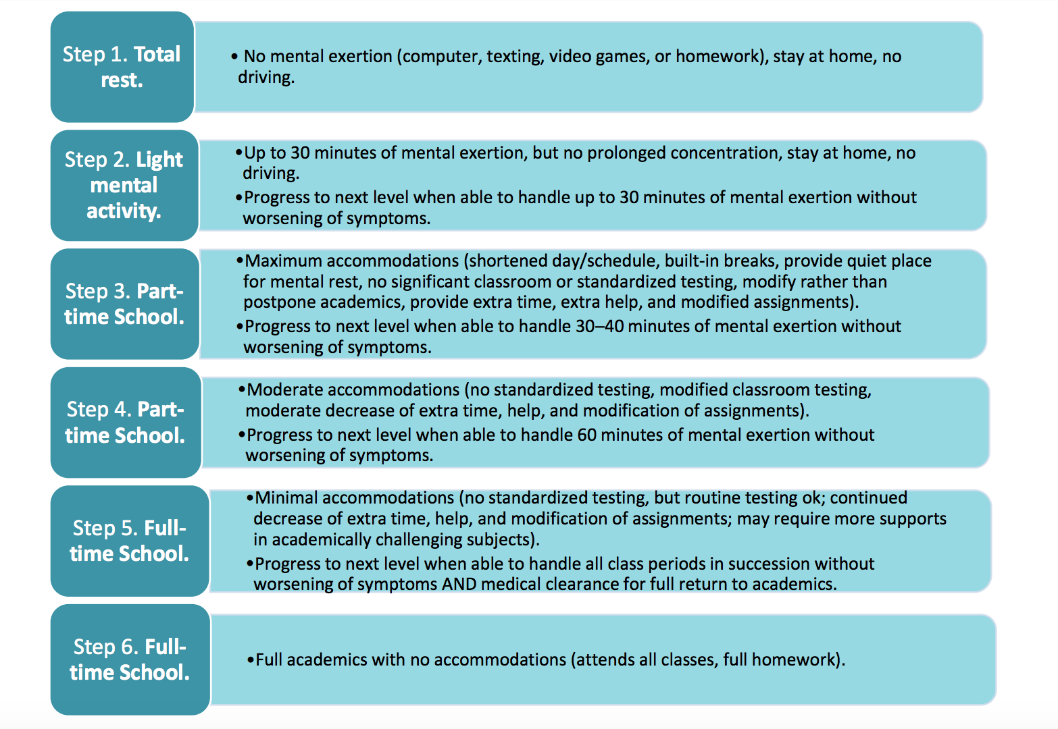
https://cbirt.org/sites/cbirt.org/files/resources/return_to_academcs.pdf

Slide 47
1. Position Statements on School Concussion Management
Multidisciplinary Participation
Communication between medical and school personnel (Brown et al., 2019; Gioia, 2016; Halstead et al., 2013; Knollman-Porter, Constantinidou, Beardslee, & Dailey, 2019; Knollman-Porter, Constantinidou, & Hutchinson Marron, 2014; McAvoy et al., 2018)
Staff education on nature of concussion and methods to support students during recovery (Dachtyl & Morales, 2017; Gioia et al., 2016; Romm et al., 2018)
SLPs have been identified to fulfill various roles on concussion management teams (Brown et al., 2019; Dachtyl & Morales, 2017; Hardin & Kelly, 2019; Ketcham et al., 2017; Knollman-Porter et al., 2019, 2014; Salvatore & Fjordbak, 2011)

Slide 48
2. Neuropsychology Treatment Literature
Treatment components
iatrogenesis
Psychoeducation emphasizing support and reassurance for recovery (McNally et al., 2018; Ponsford et al., 2001; Scheenen, Visser-Keizer, Van Der Naalt, & Spikman, 2017)
Areas to target:
Behavioral health
Increase in activity
Cognitive restructuring
Coping skills
Facilitating the expectation or context for illness (Kirkwood, Peterson, Connery, Baker, & Forster, 2016)
Over-testing
Pathologizing
“Identity as disability”

Slide 49
3. Adult Cognitive Rehabilitation Delivered by SLPs
Population
Adult mTBI
Cognitive Target
Working memory
Executive function
Therapeutic Approach
MSI
ATC
Outcome Measures
Psychoeducation
D-KEFS
BRIEF
KBCI
(Cooper et al., 2016; Sohlberg et al., 2014; Tiersky et al., 2005; Trebla-Barna et al., 2016; Twamley et al., 2014; Williams-Butler & Cantu, 2019)

Slide 50
4. Pediatric Cognitive Rehabilitation Delivered by SLPs
Population
Pediatric moderate to severe TBI
Cognitive Target
Attention
Executive function
Therapeutic Approach
Combination of drills and MSI
Outcome Measures
Standardized assessments of speech, language, and cognition
Working memory
Pediatric post-cancer treatment
(Laatsch et al., 2007; Limond & Leeke, 2005)

Slide 51
proposed treatment model
Personalized and dynamic approach to managing PCS
Three phases:
Treatment Set Up
Implementation of Treatment
Discharge Plan

Slide 52
Treatment set Up
Goal Formation
Motivational interviewing
Identify client concerns
Implementation of Treatment
Identification of psychoeducation and cognitive strategies that match client needs
Discharge Plan
Outcome measures to determine progress
Follow-up materials to promote ongoing strategy use
Use assessment responses to help guide goal selection

Slide 53
Goal Formation
Key motivational interviewing questions for adolescent clients:
What do you want to change about school right now?
What do you think is getting in the way?
What aspects of school are going well?

Slide 54
GAS Example
Goal | Increase the number of hours I attend school each day
+2 Much more than expected | I will attend school for 5 hours per day, 5 days per week
+1 More than expected | I will attend school for 4 hours per day, 5 days per week
0 Expected | I will attend school for 3 hours per day, 5 days per week
-1 Baseline | I will attend school for 2 hours per day, 5 days per week
-2 Decline | I will attend school for 1 hours per day, 5 days per week
Measurement | Parent and student reported data to the SLP each week. School reported data to SLP once per month.

Slide 55
GAS example
Goal | Improve my grades by inputting my assignments into my Google Calendar
+2 Much more than expected | I will input all assignment deadlines into the Google Calendar app 5 days out of the week
+1 More than expected | I will input all assignment deadlines into the Google Calendar app 4 days out of the week
0 Expected | I will input all assignment deadlines into the Google Calendar app 3 days out of the week
-1 Baseline | I will input all assignment deadlines into the Google Calendar app 2 days out of the week
-2 Decline | I will input all assignment deadlines into the Google Calendar app 1 day out of the week
Measurement | SLP and student reviewed the Google Calendar each week and determined progress.

Slide 56
GAS Example

Slide 57
Implementation of Treatment
cognitive strategies
Pyschoeducation
Metacognitive strategies
ATC
Concussion symptoms and expectations for recovery
Importance of maintaining activity level
Identification of negative thinking patterns (CBT approaches)
Sleep hygiene

Slide 58
Cognitive Strategies
Types of MSI
Types of ATC
Internal self talk/verbal mediation to reauditorize information
Reading comprehension/retention strategies
Prediction
Task planning sequence
Test study strategies
Visualization
Mood regulation
Paper planner/Calendar app
Task initiation chart
Smart pen for lectures
Apple iOS screen time feature corresponding to homework completion

Slide 59
Implementation of Treatment
Status tracking measurement and repeated measurements of strategy use and helpfulness
Weekly measurement of progress designed to drive collaborative discussion of client performance and self-reflection
Examples from my own research:
Pilot data link
Dissertation data link

Slide 60
Discharge Plan
When to discharge:
Consider improvements on assessments/questionnaires
Use weekly data collection to highlight sustained progress on goal
Consider client’s ability to generalize strategy use and progress on goal to other functional tasks

Slide 61
Discharge Plan
When preparing client for discharge:
Encourage client independence and ability to self-monitor
Encourage client ability to be their own clinician to reflect on performance and needs
Provide resources to reinforce concussion education and strategy use

Slide 62
Recommended Books on Concussion
Notes:
For those who are interested:
To me, concussion is really a story with so many interesting characters and competing story lines (probably why they turned it into a movie with Will Smith). These books are great at breaking down the history of how concussion awareness made its way into the mainstream. I have copies of both if anyone is interested in borrowing. ”The Concussion Crisis” details a few individuals who battle PCS and receive treatment similar to what we do in BrICC

