Slide 1
SESSION 4 SOAP NOTE

Slide 2
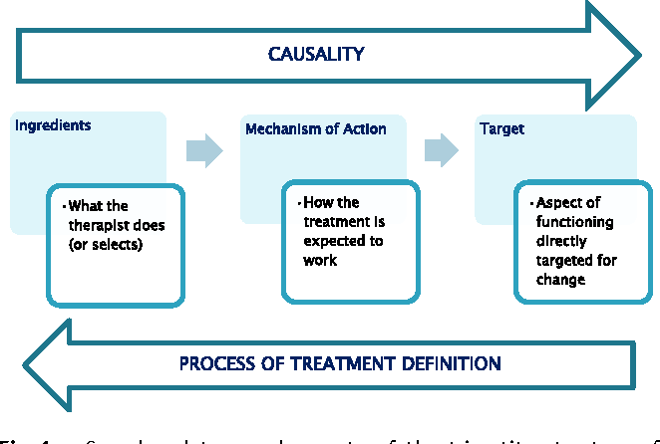

Slide 3
Activity #25: More Data Collection Practice (Session 5)
Video location: SSD 5 Matthew TX

Slide 4
Make Data Collection Efficient
Start with goals that are easy to measure
Method of data collection reflects therapy setting and tasks
  Paper and pencil not always practical
Let client take own data
Take good data less often

Slide 5
Big Picture
Assessment/Treatment Planning/Treatment Cycle
Referral, Intake, File Review
Assessment
Treatment Planning
Treatment
Session Planning
Data Collection
Differential Diagnosis
Ongoing Progress Monitoring
Programmatic Evidence
Service Delivery, Referral
Reviewing Empirical Evidence
Selecting a Treatment Approach
Determining Frequency, Duration, Service delivery
Goal Selection

